Slide 2
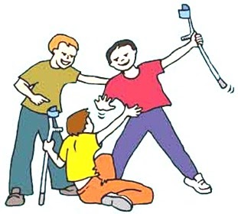
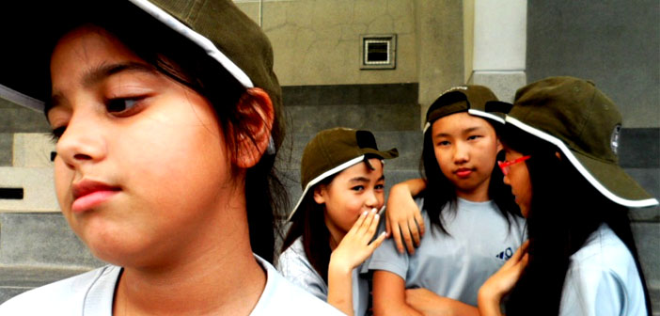
Discussion – what kind of bullying is taking place in the images? How do you think these people feel?

Slide 3
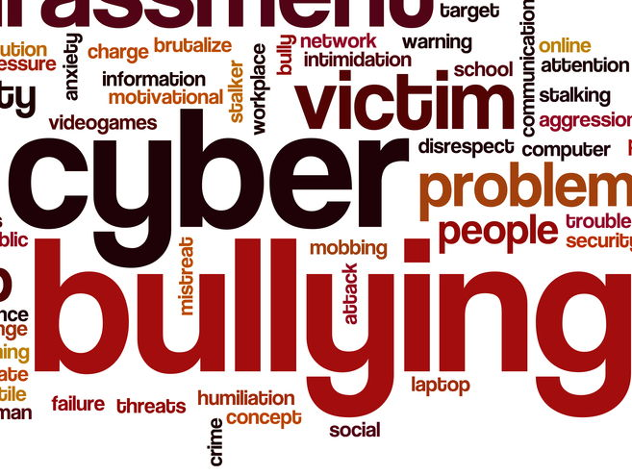
Possible Reasons for Cyberbullying
Too much spare time on their hands
Gadgets easily accessible (Phones/Tablets/iPads/Laptops)
Gives bullies a better sense of “power” because it is not face to face
The bully has the ability to remain anonymous

Slide 4
Thoughts?

Slide 5
Types of Cyber-Bullying
Instant messaging or text messaging
Stolen passwords for email, instant messaging, and other online accounts
Websites (websites that are created to tease or hurt another child)
Pictures sent through email and cell phones
Posting embarrassing pictures (Facebook/Instagram/WhatsApp) without a friends consent.
‘Tagging’ Friends without their prior knowledge.
Sending Snapchats of your ‘friends’ in compromising positions knowing it would embarrass them
Snapchatting/Taking pictures of your friends without them knowing
Writing nasty comments under people’s photos/stories etc.
Internet polling ("Who's hot, Who's not“…..)
Rumours posted on Facebook/Instagram/WhatsApp……..
Sexting
Impersonation (posing as the victim and harming other people)
Interactive gaming (X-box live, Sony Playstation network

Slide 6
Types of Social Media that can be used to Cyberbully.
Facebook
Instagram
Twitter
Email
Text messaging
Instant messaging (iMessage)
Snapchat
Skype
Vine
Ask.fm
Tumblr
Yik Yak

Slide 7
Facebook
You have to be 13 to create a Facebook account
Facebook has 1.4 billion users worldwide
It has different privacy settings which can stop other people being allowed to access your page
51% of young people in Ireland have received some form of bullying on the site, according to recent surveys.
The most common ways to be bullied on the site are via Facebook Chat and fake profiles
Ways to combat this are making sure that your profile is as secure as it can be and not accepting Friend Requests from people that you do not know.

Slide 8
You should be 13 to create an Instagram account
Instagram has 75 million daily users
9% of teenage girls claim to have been bullied on Instagram
Privacy settings can be changed to prevent anyone unwanted accessing your account
Geotagging should be turned off so your location is not visible to anyone. Anyone could keep a trace on where you go, if you do not

Slide 9
Snapchat
You have to be 13 to create a Snapchat account
Once a Snapchat has been sent the recipient has 10 seconds to save it, otherwise it disappears. Snapchat informs you if your picture has been saved. There are privacy settings which let you minimise who sees your Snapchats.
There is also a My Story page where everyone on your friends list can access your photos for 24 hours.
SnapMap - You’ll be given the option to share your location with all friends on your list, a select group of friends, or nobody, by going into “Ghost” mode. Ghost mode removes your location from the map and hides it from your friends.

Slide 10
Snapchat
The Snaps never go away
They can be screenshotted.
The person could take a picture of your Snap with another phone.
They are saved to folders which are not readily accessible to normal users.

Slide 11
Sexting on Snapchat
The “Sexting App”
Before sending a revealing photo think about what could happen if you break up or are no longer friends.
No matter how much you trust a person, please reconsider before sending. You have to think about future jobs, people you will meet…

Slide 12
The Law on Sexting
Sending Snapchats could also fall foul of child pornography laws. Under current Irish law, a 17 year old who receives an explicit image from his 16 year old girlfriend is, for instance, technically guilty of viewing child pornography.

Slide 13
Bullying on Snapchat
If you receive a bullying, abusive or otherwise unwanted message, these are the steps to go through…
Do not reply – responding will encourage them more.
Keep the message If possible.
Block the sender.
Tell someone you trust.

Slide 14
In your Journal

Slide 16
Plenary
Why has cyberbullying become so popular?
Mention 3 ways of staying safe on Facebook.
Mention 3 ways of staying safe on Snapchat.
What are the dangers of ‘sexting’?
What should you do if you receive abuse online?
What are the dangers of accepting friend requests when you do not know the person?
How do snapchat pictures stay around forever?

